Slide 1

Management of crops in rainfed areas
Delivered by
Mr. Anil Swami
Asst. Professor
Rainfed Agriculture & Watershed Management Mr. Anil Swami

Slide 2
Objective:-
Tell the soil and climatic conditions prevalent in rainfed areas.
Interpret various water harvesting techniques and their efficient utilization.
Apply contingent crop planning for aberrant weather conditions.
Examine the seasonal rainfall and different types of watershed and its components.
Select soil and water conservation techniques to avoid their losses.

Slide 3
Management of Crops in Rainfed Areas
Under rainfed conditions soil moisture is the most limiting factor for crop production.
It is lost as evaporation from soil surface and as transpiration from the plant surfaces.
The combined loss of moisture through these two processes is known as evapotranspiration.

Slide 4
Crop management practices under rainfed areas:
Efficient cropping systems
Cropping intensity in dryland agriculture is, generally 100%, implying that single crop is taken during the year.
Cropping intensities of these areas can be increased through intercropping and sequential cropping by way of more efficient use of resources.
Crops and cropping systems selected should match the length of crop growing season to avoid soil moisture stress.

Slide 5
Double cropping, either by sequential cropping or relay cropping, is possible in regions with rainfall >900 mm, extended rainy season and high soil moisture storage capacity.
Double cropping is also possible with rainwater harvesting in farm ponds.
Intercropping of groundnut + castor (4:1) was pursued vigorously in Rajkot (Gujarat).
Even at Solapur, leafy vegetables and some short duration beans are grown as intercrops during the rainy season.

Slide 6
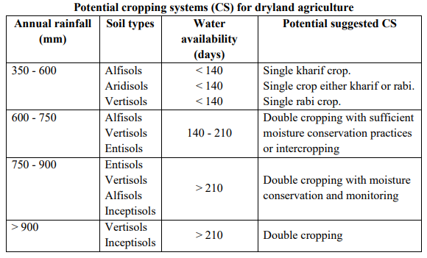

Slide 7
Choice of crops and cultivars and crop substitution Crops and varieties for drylands should have following characteristics:
Plants with erect leaves and stem.
Short duration and early vigour.
Deep root system with ramified roots.
Dwarf and moderate tillering in case of tillering crops and varieties.

Slide 8
Resistance/tolerance to biotic stresses.
Lesser period between flowering and maturity so that the grain filling is least affected by adverse weather.
Resistance/ tolerance to abiotic stresses.
Low rate of transpiration.
Less sensitive to photoperiod.
Wider adaptability.

Slide 9
Traditional cultivars are of longer duration, photosensitive, inefficient users of soil moisture and often have poor response to PoP.
The guiding principle of choice of crops, varieties and cropping systems for dry lands should be their suitability to vagaries of monsoon.
It is imperative to select crops and varieties, which possess wider adaptability, shorter duration and evade or tolerate rainfall vagaries by virtue of their ability to maintain high internal water content with deep root system and less transpiration.
Such crops and cultivars should be substituted with productive crops and cultivars.
Pulses and oilseed crops perform better than cereals if the sowings are delayed during kharif

Slide 10
Among the pulse crops, cluster bean, moth bean and horse gram are better choice for low rainfall areas relative to other kharif pulses.
Among oilseed crops, castor and sunflower perform better than groundnut under conditions of delayed sowing.
For crops on receding soil moisture during rabi, chickpea and lentil are preferred over peas and French bean.
In the rapeseed-mustard group of crops, taramira is the best choice for light soil with low moisture storage capacity, followed by Indian mustard.

Slide 11
Among the kharif cereals, coarse cereals (millets and sorghum) are better choice over maize and rice, similarly, in rabi, barley does well under conserved soil moisture than wheat.
Among the millets, Setaria (kodra) is most suited for late sown condition without any serious effect on productivity.

Slide 12
3. Land preparation
Tillage is a well-known soil and water conservation practice which makes soil surface more permeable to increase infiltration rate, which in turn reduces runoff, soil and nutrient losses and enhance crop yields.
Deep tillage in problem soils promotes better root system development and helps in higher yields during low rainfall years, leading to more efficient use of sub-soil resources.

Slide 13
Off-season or pre-monsoon tillage also has a marked impact on weed control and rainwater intake.
All the cultural practices should be done across the slope (contour cultivation) to reduce soil and water loss.
By ploughing and sowing across the slope, each ridge of plough furrow and each row of the crop act as obstruction to the runoff water.

Slide 14
4. Early sowing of crops in the season
It is an established fact that early sowing alone contributes to around 63% of the final crop yield.
Early sowing leads to optimum yield due to efficient use of growth resources besides minimizing the incidence of pests and diseases.
However, the problem is that how to sow the crop early in the season when the onset of monsoon is delayed.
The practical solution to this problem appears to be land preparation for early/timely seeding, taking advantage of summer showers.
Taking advantage of these summer showers, the land can be prepared for taking advantage of the early monsoon rains.

Slide 15
In some regions, where heavy clay soils dominate, sowing after
rains is impossible due to high stickiness of soil.
As such, sowing may be done in dry soil, 2-3 weeks before the onset of monsoon (dry seeding).
For sorghum on black soils, dry seeding is recommended at 1-2 weeks before onset of monsoon with depth of sowing at 5 cm and seed hardening with potassium di-hydrogen phosphate or potassium chloride.
For cotton on black soils, dry seeding is recommended at 2-4 weeks before commencement of monsoon, with a sowing depth of 5 cm and seed hardening with CCC (500 ppm) or potassium chloride or 2% DAP.

Slide 16
5. Planting patterns and plant densities
Crop geometry refers to the arrangement of plant population (intra and inter-row spacing) in the field.
Choosing the optimum plant population and width of row spacing continues to be one of the most difficult challenges for dryland farmers.
At too densities, crop yields are reduced because too much of soil water is used up to vegetative growth early in the season; too low densities do not effectively exploit available moisture.

Slide 17
Recommendations are frequently made that do not differentiate between crop grown on stored moisture (Sept.-Oct. to Jan.-Feb.) and those grown during rainy season (June-July to Oct.-Nov.).
For crops grown during rainy season, the usual recommendation is to increase the distance between plants within the row, to adjust to a low moisture supply.

Slide 18
6. Managing soil crust problems
Soil crusts are dry, thin and hard soil surface layers that develop due to the action of rain drop or irrigation water.
On subsequent drying, it results in the development of continuous layer of closely packed soil particles.
Soil crusts often hinder the emergence of seedlings and hence establishment of crop stand.
Management practices to overcome crust problems include:

Slide 19
Shallow and dense sowing.
Dragging heavy thorny branches on crusted soil surface.
Loosening the crusted surface by using spike-tooth harrow.
Mulching.
Light blade harrowing 2-3 days after rain.
Planting on shallow furrows and on sides of ridge

Slide 20
7. Minimizing Evaporation losses
There are three principles of evaporation control under field conditions.
Decreasing the turbulent transfer of water vapor to the atmosphere by growing plants, raising wind breaks, straw mulches etc.,
Decreasing capillary conductivity by rapid drying of the surface soil layers.
Decreasing the capillary flow and moisture holding capacity of the surface soil layers.
For evaporation control, mostly mulches are used.

Slide 21
7.1 Mulches
Mulch is any covering material applied on the soil surface to reduce evaporation losses.
This material may be grown and maintained in place, or any material grown and modified before placement or any material processed or manufactured and transported before placement.
Or Mulch is any material (crop residues, leaves, bark, manure, paper, plastic films, petroleum products, gravel, coal etc.) used to cover the soil surface.
Mulches are used for various reasons but water conservation and erosion controls are undoubtedly the most important for agriculture in dry lands.

Slide 22
7.1.2 Types of mulches
Based on the material used for mulching, mulches can be classified into following categories:
Organic mulches:
In this, crop residues of cereals and pulses, straw or stalks of cotton, pigeonpea, rapeseed-mustard etc or stubbles of the crops such as maize, sorghum, sugarcane including roots or husks of the seed of various crops or saw dust are left on the soil surface or spread on the soil surface.
Use of such materials as mulches help in soil and moisture conservation, enhances nutrient availability; reduce soil crusting, soil salinity control, soil structure improvement, crop quality control, weed control and moderate soil temperature.

Slide 23
b. Soil mulch:
In soil mulching, a thin layer of loose soil surface that can be created by frequently stirring the soil with surface tillage implements like danthis, guntakas (blade harrows) etc.
Surface mulch of dry soil of about 5 to 8 cm depth is created by stirring the surface soil to turn it into fine dust particles.
By adopting this practice, some amount of moisture is lost from the upper layer.
After the preliminary loss of moisture, the soil mulch effectively controls further evaporation from sub-soil by breaking the capillaries continuity.

Slide 24
The soil mulch also prevents deep cracks in soils (especially black soils) by reducing the direct action of atmosphere and hence evaporation is also reduced.
The repeated inter-cultivations done in rabi crops even in the absence of weeds help in reducing evaporation losses.
This system of mulching is highly suitable for moisture conservation in medium to heavy texture soils, which tend to shrink and crack deeply on drying. Among the different mulches soil mulch is the cheapest.

Slide 25
c. Dust mulching:
The cracks are filled and covered by the loose layer of dust mulch.
It is used as a mid-season correction measure for moisture conservation.
d. Straw and stubble mulch:
Straw and other crop residues like stubbles, groundnut shells, cotton stalks etc; can be used as mulches on soil surface for moisture conservation.
Straw mulches reduce both the amount of energy absorbed by the soil and its movement above the soil and hence reduce evaporation.
However, the availability of adequate crop residues is a problem for use as mulches.

Slide 26
e. Chemical mulches:
In chemical mulching, aluminum foils, plastic, polythene sheets etc. are spread on the soil surface to moderate soil temperature for controlling weeds, to optimise temperature for germination of seeds and to induce runoff of rainwater for ex-situ water conservation and harvesting.
Beside this, some chemicals such as hexadecanol (a long chain alcohol) when mixed in the top 6 to 7 mm soil layer, results in a significant reduction of about 40% evaporation.
The surface layer of a treated soil dries out more rapidly than that of untreated soil, creating a diffusional layer to evaporation.

Slide 27
f. Plastic mulches:
Plastic mulches are very effective as mulches for evaporation control provided cost is not a limiting factor.
The plastic mulches may be either white or black.
Black plastic mulches will absorb the solar radiation and enhance the soil temperature for hastening the germination of winter crops like wheat; barley etc.,
White plastic mulches will reflect the incident radiation and reduce evaporation of soil moisture.

Slide 28
g. Vertical mulching:
In heavy black soils, where infiltration of rainwater is a problem, vertical mulching can be practiced keeping straw/ stalk/ stubbles as vertical mulch where in trenches of 40 cm wide, 15 cm deep are dug at 2 to 4 m interval across slope and filled with stubbles or organic wastes to a height of 10 cm above soil surface.

Slide 29
Around vertical mulching, soils remained porous for longer period, thus maintains high rate of infiltration during the rainy season.
Vertical mulching has been found to enhance available soil moisture by 4 to 5 cm.
Runoff is checked, collected in the shallow trenches and redistributed to adjoining soil layers and infiltration is increased in black soils.

Slide 30
h. Live mulching:
Is the term used to describe the covering of soil surface through the plant canopy in intercropping system.
Eg. Sorghum + forage cowpea, sorghum + sword bean

Slide 31
Pebble mulch:
Where small pebbles like stone are placed on the soil surface.
This mulching will be successful in dryland fruit tree culture.
The pebbles placed on the basins of trees not only reduce evaporation but also facilitate infiltration of rain water into the basin.

Slide 32
Mulching is more advantageous during rabi/summer months than in kharif season.
Organic mulches particularly under receding soil moisture conditions increase crop growth by conserving soil moisture.

Slide 33
7.1.3 Effect of mulches on soil properties
Soil structure:
Surface mulches reduce the impact of falling raindrops, thus reducing dispersion and sealing of soil pores leading to crust formation. Hence the soil structure is protected.
The mulches also improve soil structure due to decomposition of mulch.

Slide 34
2. Soil salinity:
Under dry land conditions due to limited precipitation, soluble salts move only to a limited depth and readily return to the surface as the soil water evaporates.
Due to salt accumulation in surface layers the germination and seedling establishment may be adversely affected.
Hence, mulches will reduce soil salinity problem by increasing infiltration and reducing evaporation.

Slide 35
3. Soil water:
The soil moisture content is improved by induced infiltration, reduced evaporation and reduced transpiration by weeds.
Surface mulches also obstruct the free exchange of water vapor from soil surface into the atmosphere and hence increase soil water content.

Slide 36
4. Soil temperature:
The effects of mulches on soil temperature are highly variable and depend up on the type of mulch material.
White or reflective types of plastic mulches generally decrease soil temperature, while black plastic mulches may increase soil temperature.

Slide 37
Crop residues moderate temperature by decreasing it in summer and by increasing in winter season.
This is due to combined effect of radiation interception and evaporative cooling.
The sugarcane trash mulch will enhance the germination of sugarcane setts during summer by temperature reduction.

Slide 38
5. Soil erosion:
The ease by which soil particles are moved by wind and water is related to size of soil particles and wind and water velocity.
The particles of size greater than 0.84 mm in diameter are generally not eroded by wind but they are easily eroded by water.

Slide 39
The mulches reduce the direct impact of falling raindrops on soil, thereby preventing soil dispersion and consequent sealing of soil pores leading to reduced soil erosion.
Loss of soil moisture through evaporation from soil surface and through transpiration from plant surfaces can be minimised by using mulches and antitranspirants.

Slide 40
8. Reducing losses due to transpiration
Nearly 99% of water absorbed by the plant is lost in transpiration.
Hence transpiration reduction is needed for maintaining favorable water balance in the plants.
Transpiration has become unavoidable evil as the stomata, which allow CO2 exchange also allows water vapour transfer into the atmosphere.
There are four principles of transpiration control

Slide 41
By increasing leaf resistance to water vapor transfer by application of materials, which tend to close or cover stomata (ex: both stomatal closing and film forming type of anti-transpirants).
By reducing amount of energy absorbed by leaf surface (Eg: leaf reflectants)
By reducing top growth of plants ( Eg: Growth retardants )
By increasing air resistance to water vapor transfer by shelter belts/ wind breaks
The transpiration losses can be controlled by use of Anti-transpirants, use of Wind Breaks/Shelter Belts and Efficient Weed Control.

Slide 42
8.1 Anti-transpirants
Any material that is applied to transpiring plant surfaces with the aim of reducing or inhibiting water loss from plant surface is called anti-transpirants.
The anti-transpirants are also known as transpiration suppressants. The best anti-transpirants reduce transpiration losses up to 30-40%.
The possibility of reducing plant transpiration by chemical without reducing photosynthesis is of great practical importance in arid and semi-arid regions.
Where crop production is limited by water scarcity, the maintenance of favourable water balances in plants is must. However, the potential use of anti-transpirants is not restricted to water conservation.

Slide 43
8.1.1 There are four principles of transpiration control:
By increasing leaf resistance to water vapour transfer by application of materials which tend to close or cover stomata. Both stomatal closing and film forming type of antitranspirants are used for this purpose.
By reducing amount of energy absorbed by leaf surface (leaf reflectants).
By reducing top growth of plants (growth retardants).
By increasing air resistance to water vapour transfer by shelterbelts/ windbreaks

Slide 44
8.1.2 There are four types of antitranspirants.
Stomatal closing type:
Transpiration mostly occurs through stomata on the leaf surface.
Some fungicides like PMA (phenyl mercuric acetate) and herbicides like atrazine in low concentrations serve as antitranspirants by closing of stomata.
PMA is known to inhibit mesophyll photosynthesis.
Though the success was reported from glasshouse studies, their effectiveness under field conditions is limited.

Slide 45
b. Film forming type:
The plastic and waxy materials, which form a thin film on the leaf surface, retard the escape of water due to formation of physical barrier.
The success of these chemicals is limited since they also reduce photosynthesis.
The desirable characteristics of film forming type of antitranspirants are: they should form a thin layer, they should be more resistant to the passage of water vapour than carbon dioxide and the film should maintain continuity and should not break.
These film forming antitranspirants may be of either thin film or thick film.
Thin film forming type: Hexadeconol Thick film forming type: Mobileaf, Polythene S-60

Slide 46
c. Leaf reflectant type:
These are the white materials, which form a coating on the leaves and increase leaf reflectance (albedo).
By reflecting the radiation they reduce leaf temperatures and vapour pressure gradient from leaf to atmosphere and hence reduces transpiration.
About 5% of kaolin spray reduces the leaf temperature by 3- 4°C and decrease in transpiration by 22 to 28 per cent.
Celite and hydrated lime are also used as reflectant type of anti transpirants.

Slide 47
d. Growth retardant type:
These chemicals reduce shoot growth and increase root growth and thus enable the plants to reduce transpiring surface and resist drought conditions.
They increase root/shoot ratio. Eg : Cycocel – (2-chloroethyl) Trimethyl ammonium chloride (CCC), Phosphon–D, Maleic Hydrazide (MH) Antitranspirants generally reduce photosynthesis.

Slide 48
Therefore, their use is limited to save the crop from death under severe moisture stress.
If crop survives, it can utilize the rainfall that is received subsequently. Antitranspirants are also useful for reducing the transplantation shock of nursery plants.
They have some practical use in nurseries and horticultural crops. Waxy materials are used for reducing post-harvest shrinkage of fruits.

Slide 49
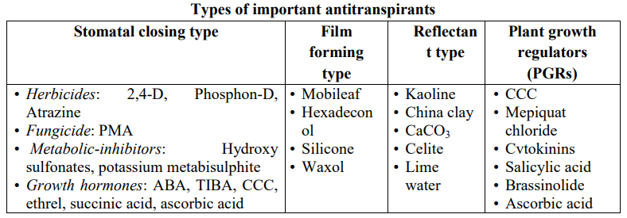

Slide 50
8.2 Use of wind breaks and shelterbelts:
Wind breaks are any structures that obstruct wind flow and reduce wind speed while shelterbelts are rows of trees planted for protection of crops against desiccating wind, reduce soil erosion and create a suitable micro-climate.
Generally, shelterbelts give protection from desiccating winds to the extent of 5-10 times their height on windward side and upto 30 times on leeward side.
A conical cross-section of windbreaks will provide the best protection from the winds.

Slide 51
The direction from which wind is blowing is called windward side and direction to which wind is blowing is called leeward side.
Shelterbelts are planted across the direction of wind.
They do not obstruct the wind flow completely.
Depending upon their porosity, certain amount of wind passes through the shelterbelts while the rest deflects and crosses over the shelterbelts.
It thus reduces wind speed without causing turbulence.

Slide 52
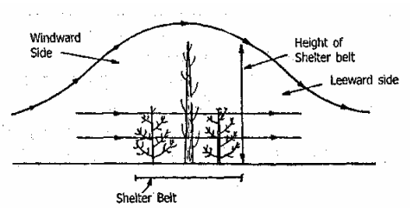

Slide 53
The protection offered by the shelterbelts is dependent on the height of central tree row in the shelterbelts.
Generally, shelterbelts give protection from desiccating winds to the extent of 5 to 10 times their height on windward side and up to 30 times on leeward side.
Due to reduction in wind speed, evaporation losses are reduced and more water is available for plants.
The beneficial effect of shelterbelts is seen more clearly in drought years.
In addition, shelterbelts reduce wind erosion.

Slide 54
8.3 Effective weed control:
Weeds transpire frequently greater amount of water per unit of dry matter production than the crop plants.
Therefore controlling weeds especially at early stages of crop growth will be most effective means of increasing the amount of water available for crops.
This is the most useful method to reduce transpiration losses.
Weed management can be achieved through judicious management using good crop agronomy and a variety of weed management strategies.

Slide 55
Weed competition in crop field is invariably severe in early stages of crop growth than at later stages.
Generally, in a crop of 100 days duration, the first 35 DAS should be maintained weed free for optimum yield.
In general, crops must be maintained weed free during the first one-third period of life cycle.
The IWM combines different agronomic practices, mechanical, biological and herbicides use to manage weeds, so that the reliance on any one weed control technique is reduced.

Slide 56
9. Nutrient management
Indian dryland are not only thirsty but also hungry. Studies on the extent of nutrient deficiencies indicated that dryland soils are universally deficient in N, medium in P and high in K content.
The stained crop production on these soils requites regular nutrient inputs through chemical fertilisers and organic manures to replenish soil nutrient reserves depleted by crops.
The quantum of nutrients available for recycling via crop residues and animal manures is grossly inadequate to compensate for the amounts removed.

Slide 57
Following are the salient findings on fertiliser use in dryland agriculture:
1. Soils of dry regions are deficient in N in all soils, P in some soils, K is limited and Zn and Fe are sporadically. Most economical responses were with low rates of 25-30 kg N /ha. On heavy black soils, crops respond to about 30 kg P₂O₅ /ha. Legumes in cropping system contribute up to 25 kg N /ha.

Slide 58
2. Response of post-rainy season crops to fertilisers will depend on stored moisture in the profile and hence should be band placed in soil as basal application.
3. For kharif crops, N can be applied in splits depending on rainfall. Second split may be avoided if the soil moisture is not adequate for top dressing in time. Legumes are more responsive to P fertilisation.
4. Balanced fertiliser use resulted in yield advantage during normal rainfall year.

Slide 59
Thus, IPNS approach has come to play a key role in these areas.
IPNS involves judicious and combined use of fertilisers, bio-fertilisers, organic manures and growing of legumes in the cropping systems. IPNS also encompasses balanced fertilisation and SSNM.
In case of Zn deficiency, 30 kg of zinc sulphate is applied once in three years.

Slide 60
Mid-season corrections
Aberrant weather like late onset of monsoon, dry spell immediately after sowing, prolonged breaks during the crop period and early withdrawal of monsoon are common features of rainfed agriculture.
The success of the implementable recommendations, largely, depends on the severity of soil moisture stress and stage of crop growth at which the crop is subjected to soil moisture stress.
To boost production some practices are adopted as per the situation exists like-

Slide 61
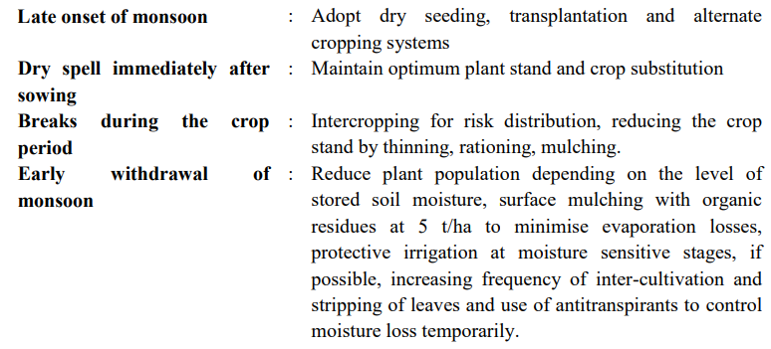

Slide 62
11. Alternate land use systems
Choice of land use systems viz., mono-cropping, double cropping, mixed cropping, mixed farming, agri-horticulture and silvi-pastoral should be practiced depending upon the rainfall, soil type and other climatic conditions.
12. Protective irrigation to crops from harvested rainwater is the best way to save crops.

Slide 63
Thank You
Rainfed Agriculture & Watershed Management Mr. Anil Swami

